Slide 1
User Stories Agile Methodology HEE Learning Hub

Slide 2
What is a user story?
Is a tool used in agile project methodology to capture product functionality
Helps shift the focus from technical and functional views to the user and how they interact with the system
User stories are short, simple descriptions of a feature told from the perspective of the person who requires/desires the new capability, usually a user or customer of the system.

Slide 3
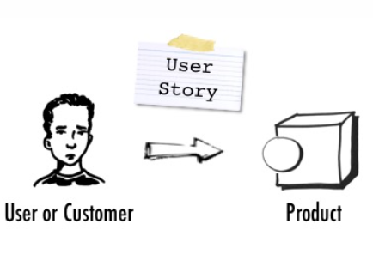
Purpose of user stories
A user story describes how a user employs the product; it is told from the user’s perspective.
This Photo by Unknown Author is licensed under CC BY-SA

Slide 4
Top tips
1 Identify the users
Users come first! You need to be confident you are involving the right people who can provide a user’s perspective.
Try to split the users into personas. Personas enables the splitting of users into common user groups who will be carrying out the same functions in the system.

Slide 5
User Personas/Types - Examples
Here are a few examples of user personas or types that we have for the Learning Hub:
Learner
Tutor
Manager
Author
Trust admin/reporter
HEE admin/reporter

Slide 6
Top tips
2 Keep the stories simple and concise
Focus on what is important. Write your stories so they are easy to understand. Keep them simple and precise. By using sticky notes you are able to facilitate collaboration and stories can be easily grouped to check for consistency.

Slide 7
User story - template
As <User type/Persona>,
I want <what feature>,
so that <why the feature is needed, the benefit>.
This template focuses on providing a concise response making the benefits explicit. Avoid using confusing or ambiguous terms.

Slide 8
User story - examples
From the previous examples of personas, let’s look at a few statements for a learner:
As a learner,
I want to find learning relevant to me,
so that I can develop in my role and onto my next.
As a learner,
I want to see the learning I have completed,
so that I can prove my personal development.

Slide 9
User story - examples
From the previous examples of personas, let’s look at a statement for a manager and an author:
As a delegated supervisor,
I want to see my team’s completed learning,
so that I can keep track of how my team are developing.
As an author,
I want to be able to upload my content,
so that others can learn from my experience.

Slide 10
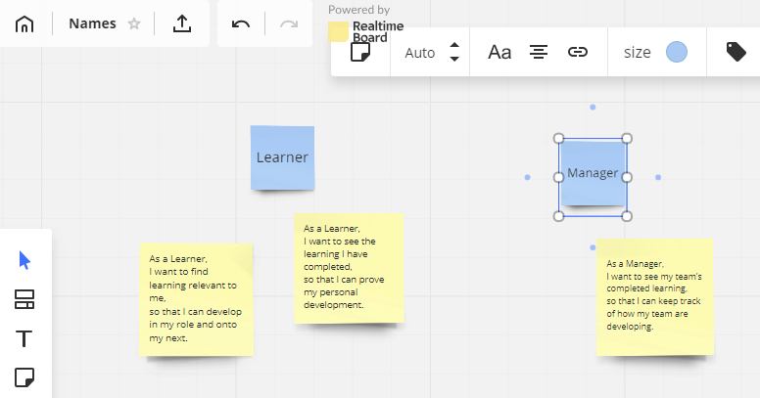
User story - writing them up
Physical whiteboard, or widely available online tools.
Learner
Manager
As a Learner,
I want to find learning relevant to me,
so that I can develop in my role and onto my next.
As a Learner,
I want to see the learning I have completed,
so that I can prove my personal development.
As a Manager,
I want to see my team’s completed learning,
so that I can keep track of how my team are developing.

